Slide 1
Linear Relationships
Introduction

Slide 2
Population
Notes:
https://www.emaze.com/@AFZLCRZF/PopulationDominican

Slide 4
Notes:
https://www.youtube.com/watch?v=Xn7Sd5Uu42A

Slide 5
What is gradient?
Gradient is the measure of how steep a line is. The bigger the gradient, the steeper the line.

Slide 6


Small gradient
Large gradient

Slide 7
Consider a linear relationship
y
y = mx + c
m = gradient of the line
x

Slide 8
The RED line has a larger gradient than the BLUE line.
8
7
6
5
4
3
A big gradient gives a STEEP line
2
1
-1
-2
A small gradient gives a SHALLOW line
-3
-4
-5
-6
-7
-8

Slide 9
8
7
6
The RED line has a positive gradient, the BLUE line has a negative gradient
5
4
3
2
1
-1
-2
-3
-4
-5
-6
-7
-8

Slide 10
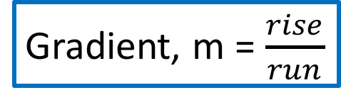
How do you define the gradient?
y
y = mx + c
rise
run
x
Gradient, m = $\frac{rise}{run}$

Slide 12
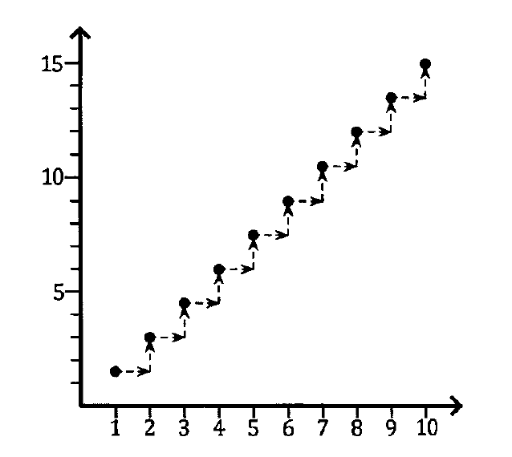
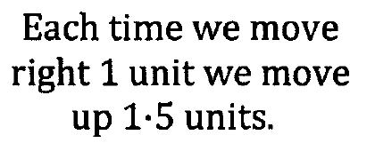
Gradient = 1.5

Slide 13
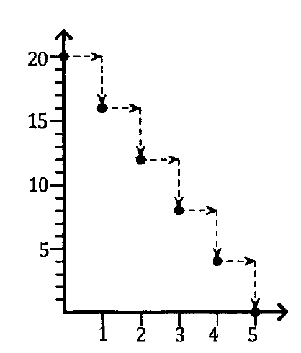
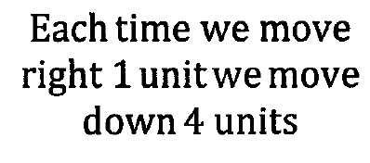
Gradient = - 4

Slide 14
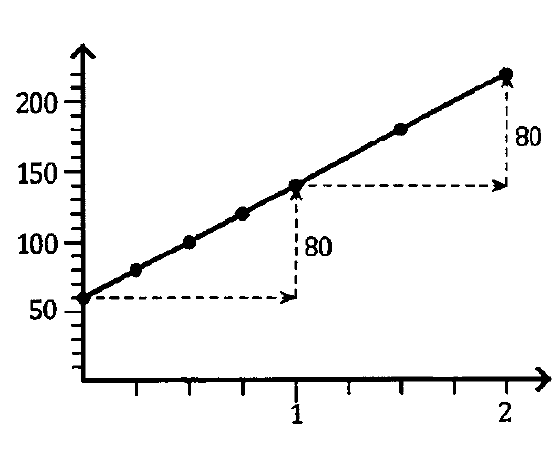
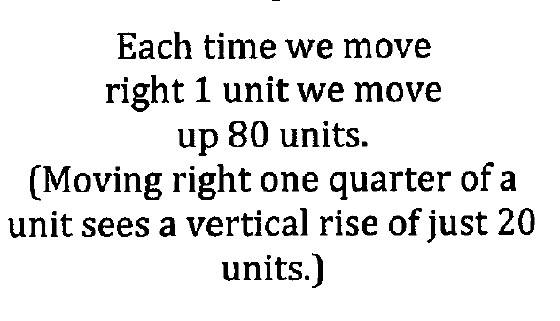

Slide 15
Table of values
1
1
1
1
1
1
-3
-3
-3
-3
-3
-3
The difference = the gradient, m
Therefore in this case, m = -3

Slide 16
1
1
1
1
1
1
-2
-2
-2
-2
-2
-2
The difference = the gradient, m
Therefore in this case, m = -2

Slide 17
1
1
1
1
1
1
5
5
5
5
5
5
The difference = the gradient, m
Therefore in this case, m = 5

Slide 18
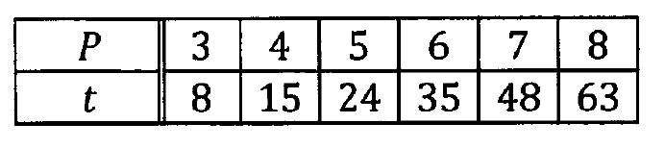
1
1
1
1
1
7
9
11
13
15
Difference is not constant, therefore this graph is not a linear graph.

Slide 19

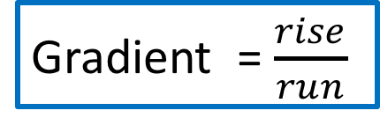
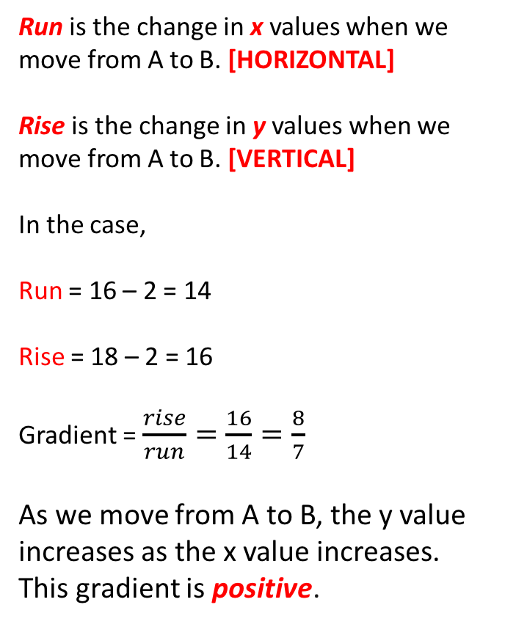
y
Gradient = $\frac{rise}{run}$
Run is the change in x values when we move from A to B. [HORIZONTAL]
Rise is the change in y values when we move from A to B. [VERTICAL]
In the case,
Run = 16 – 2 = 14
Rise = 18 – 2 = 16
Gradient = $\frac{rise}{run}=\frac{16}{14}=\frac{8}{7}$
As we move from A to B, the y value increases as the x value increases. This gradient is positive.
B (16,18)
rise
A (2,2)
run
0
x

Slide 20
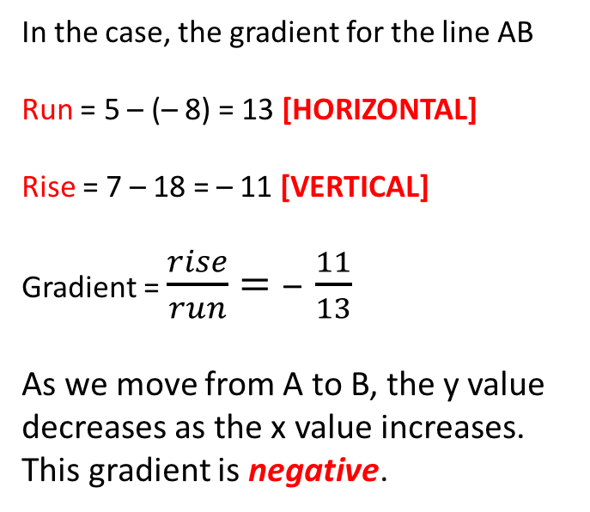
y
In the case, the gradient for the line AB
Run = 5 – (– 8) = 13 [HORIZONTAL]
Rise = 7 – 18 = – 11 [VERTICAL]
Gradient = $\frac{rise}{run}=\text{–} \frac{11}{13}$
As we move from A to B, the y value decreases as the x value increases. This gradient is negative.
A (-8,18)
rise
B (5,7)
run
0
x

Slide 21
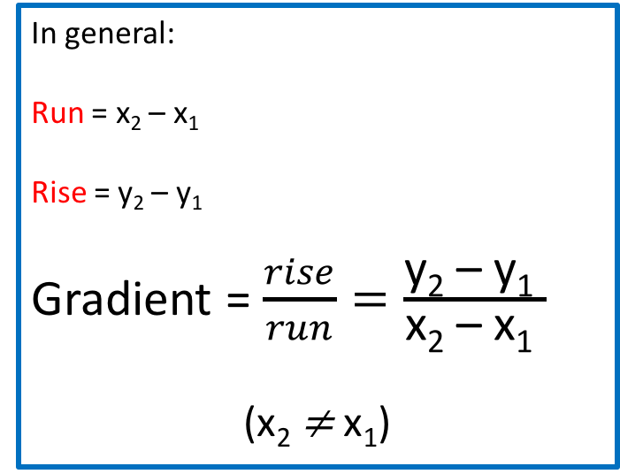
y
In general:
Run = x₂ – x₁
Rise = y₂ – y₁
Gradient = $\frac{rise}{run}=\frac{\text{y}\text{2} \text{–} \text{y}\text{1} }{\text{x}\text{2} \text{–} \text{x}\text{1} }$
($\text{x}\text{2} \text{≠} \text{x}\text{1}\text{)}$
B (x₂, y₂)
rise
A (x₁, y₁)
run
0
x

Slide 22
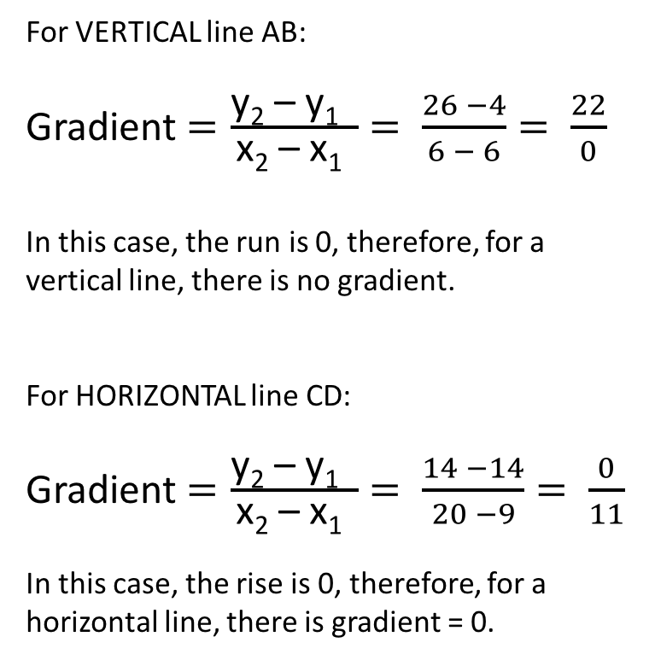
y
Vertical line Gradient:
UNDEFINED
For VERTICAL line AB:
Gradient $=\frac{\text{y}\text{2} \text{–} \text{y}\text{1} }{\text{x}\text{2} \text{–} \text{x}\text{1} }= \frac{26 −4}{6 − 6}= \frac{22}{0}$
In this case, the run is 0, therefore, for a vertical line, there is no gradient.
For HORIZONTAL line CD:
Gradient $=\frac{\text{y}\text{2} \text{–} \text{y}\text{1} }{\text{x}\text{2} \text{–} \text{x}\text{1} }= \frac{14 −14}{20 −9}= \frac{0}{11}$
In this case, the rise is 0, therefore, for a horizontal line, there is gradient = 0.
B (6,26)
C (9, 14)
D (20, 14)
Horizontal line Gradient = 0
A (6,4)
0
x

Slide 23
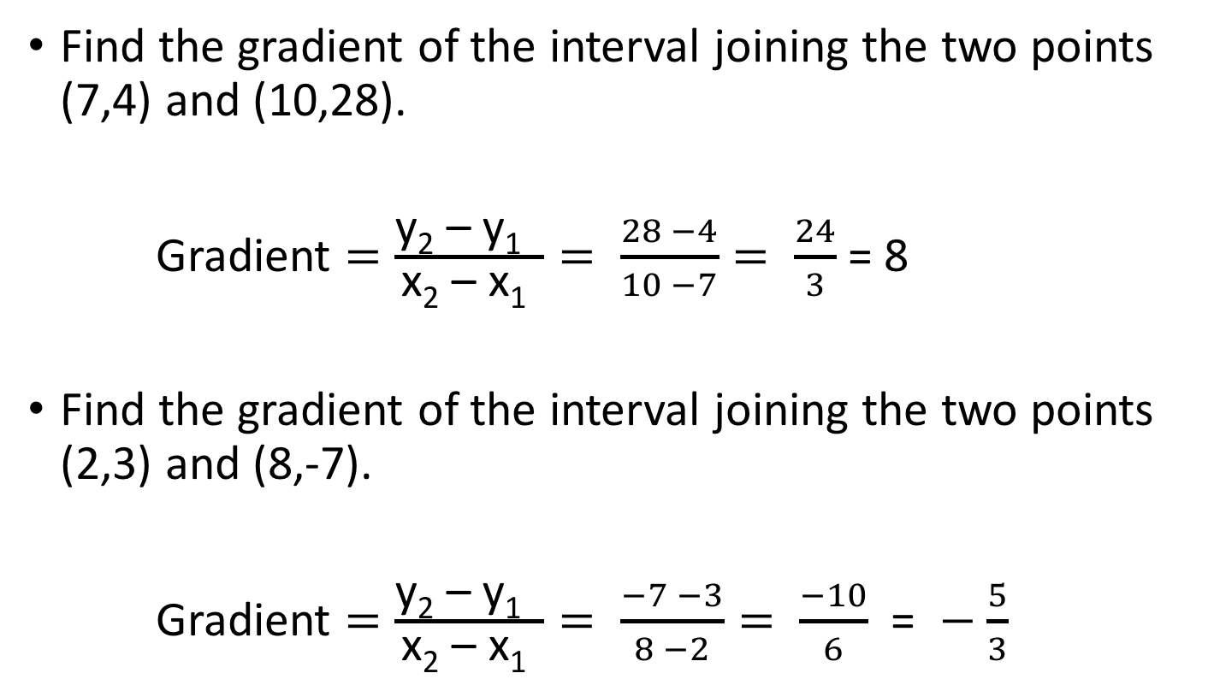
Examples
Find the gradient of the interval joining the two points (7,4) and (10,28).
Gradient $=\frac{\text{y}\text{2} \text{–} \text{y}\text{1} }{\text{x}\text{2} \text{–} \text{x}\text{1} }= \frac{28 −4}{10 −7}= \frac{24}{3}$ = 8
Find the gradient of the interval joining the two points (2,3) and (8,-7).
Gradient $=\frac{\text{y}\text{2} \text{–} \text{y}\text{1} }{\text{x}\text{2} \text{–} \text{x}\text{1} }= \frac{−7 −3}{8 −2}= \frac{−10}{6}$ = $−$ $\frac{5}{3}$

